Slide 1
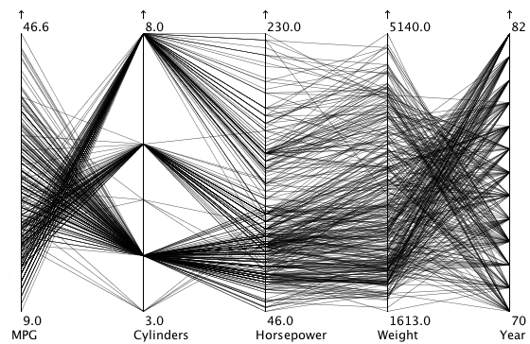
Notes:
Since the variables along the x axis are not comparable on the same chart, the length and angle of lines are misleading

Slide 2
Chevy
Nova

Slide 3
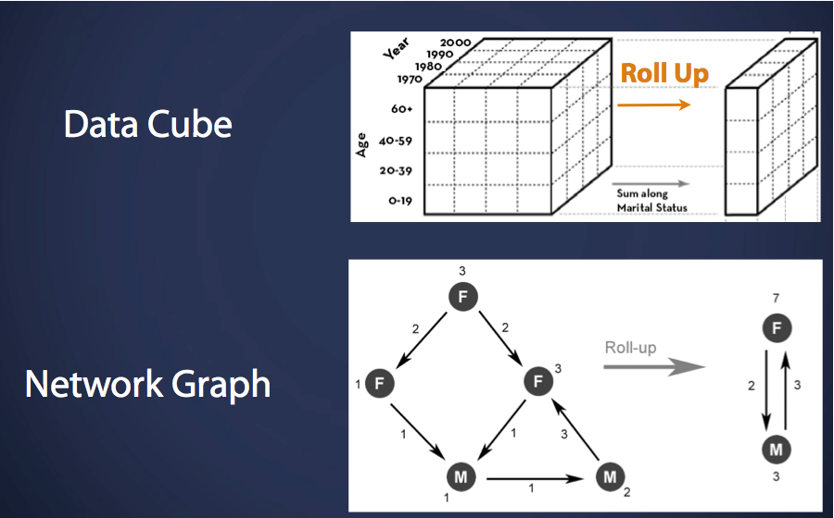

Slide 4
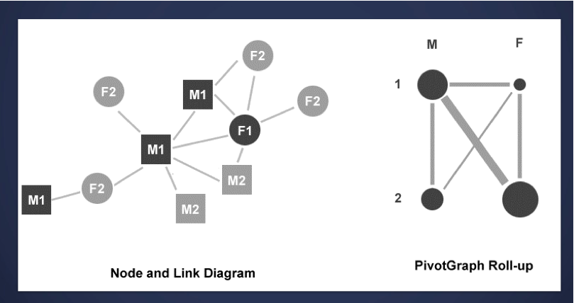

Slide 5
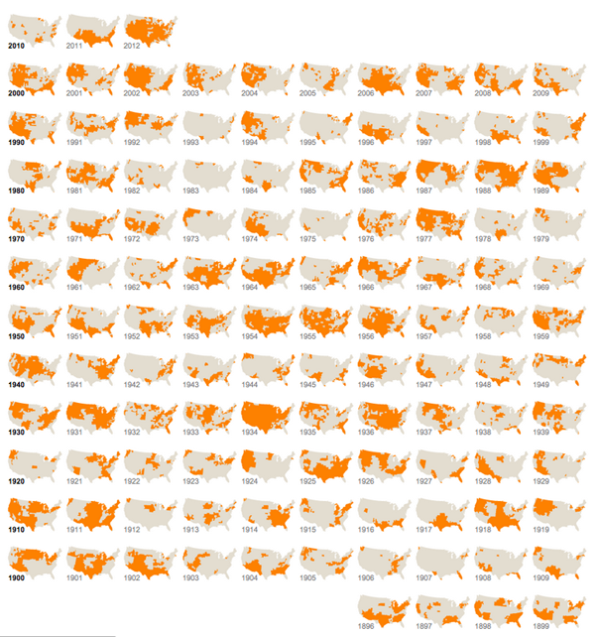
Drought footprint
http://www.nytimes.com/interactive/2012/07/20/us/drought-footprint.html?_r=0

Slide 6
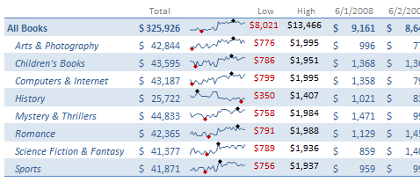

Slide 7
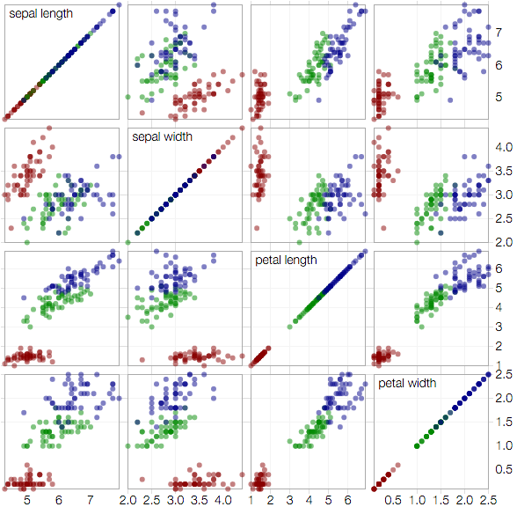

Slide 8
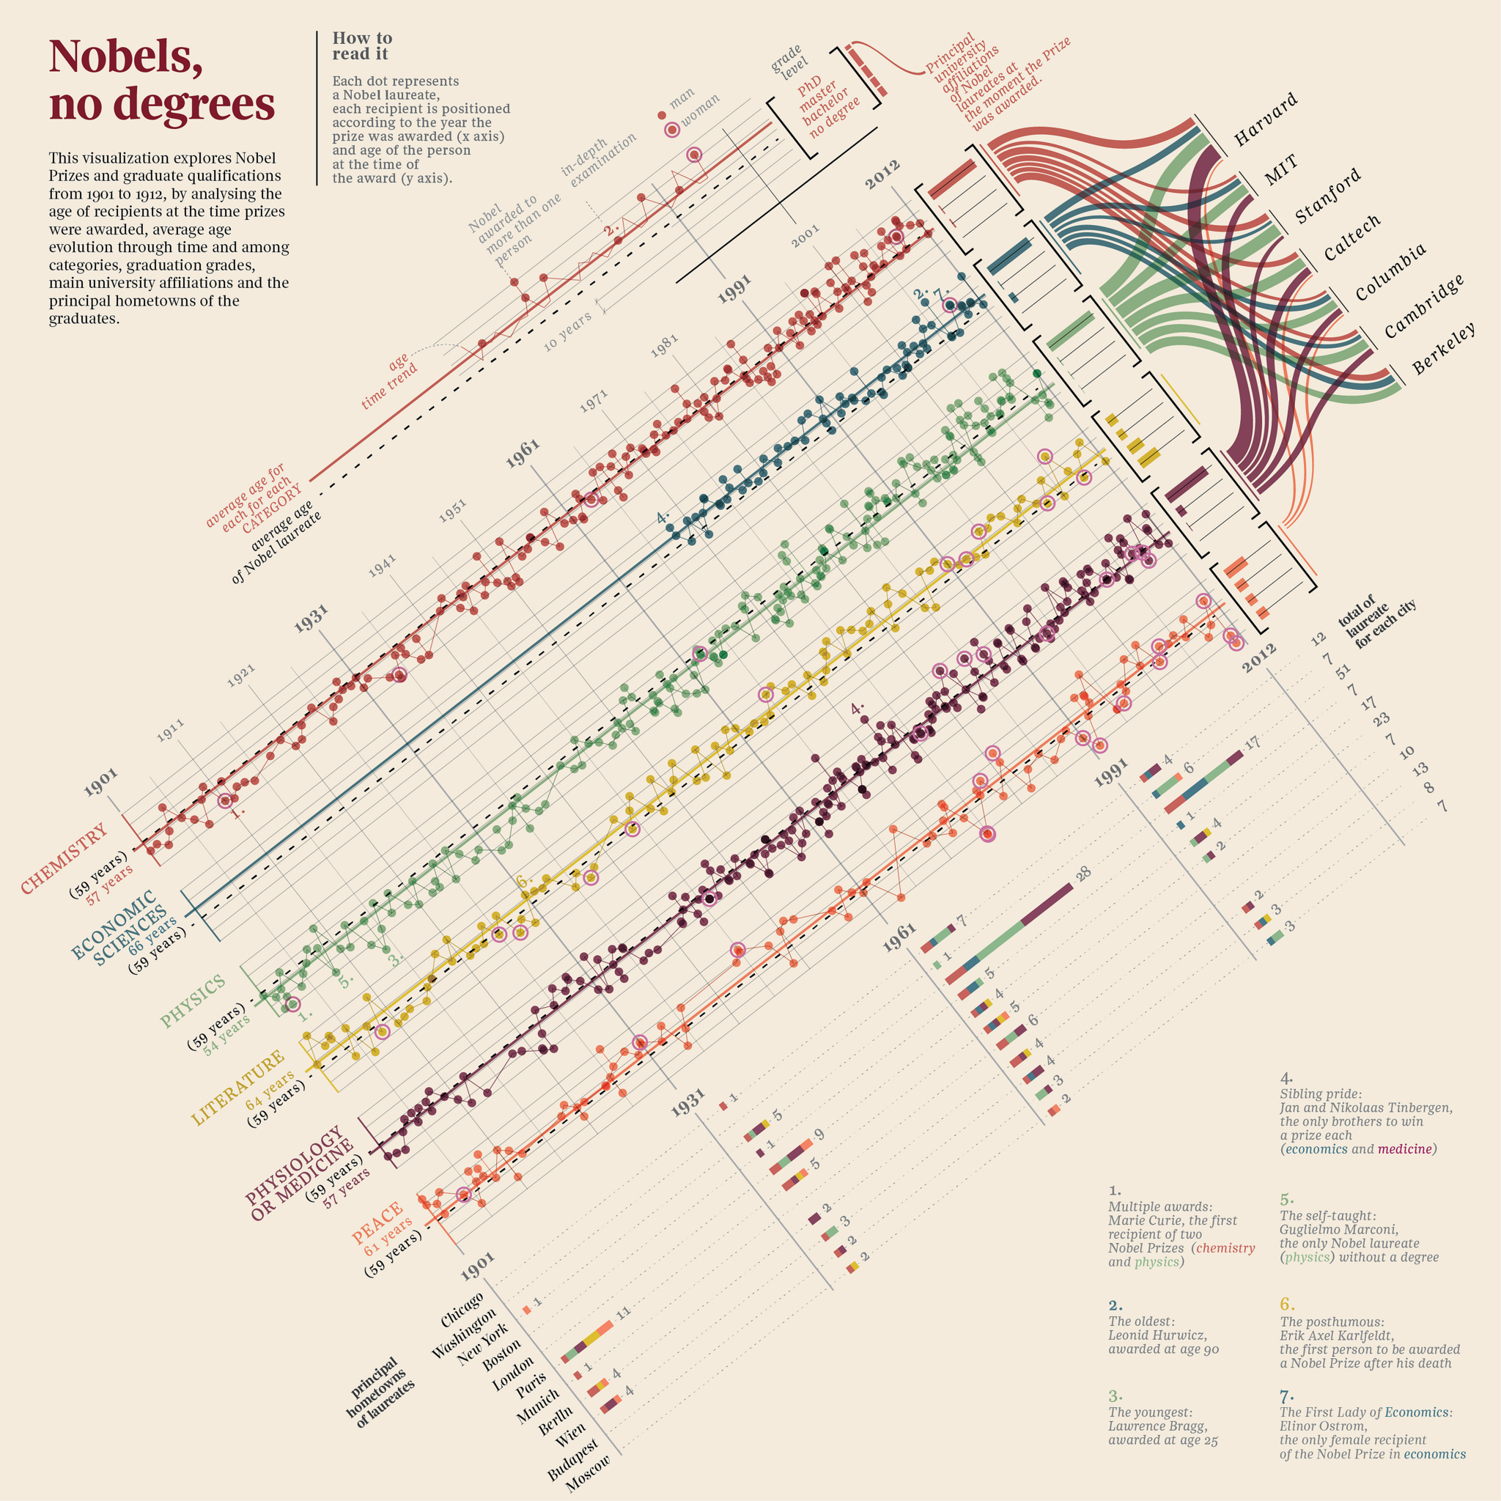
Creators: accurat.it
Notes:
2013 winner of Information is Beautiful contest

Slide 9
Nobel
No degrees
Notes:
After turning it right side up and blowing it up a bit you can see the authors looked at age, gender, type of degree, type of peace prize. Spark lines, bar charts, scatter plot, and pivot graph. The conclusion is that for the most part, few Nobels are awarded without degrees, hence the title “Nobels, no degrees.”
I have conducted some significant research of my own and come up with three alternative titles.

